Slide 1
Final Exam: Create an Information Visualization
By: Christopher Paez

Slide 2

Hello Rookie!
Welcome to my information visualization
In this PowerPoint I will teach you the ropes. Specifically, I will lay out Johnson’s principles of design and also incorporate Gestalt’s principles as well.
I will also go more in depth with the insect finder application we are using to help senior citizen scientists to more accurately research insects.
Welcome aboard! Make sure you pay attention!

Slide 3

Part A: Johnson’s Principle 1: Focus on the users and their tasks, not on the technology
• Understand the users.
• Understand the tasks.
• Consider the context in which the software will function.

Slide 4
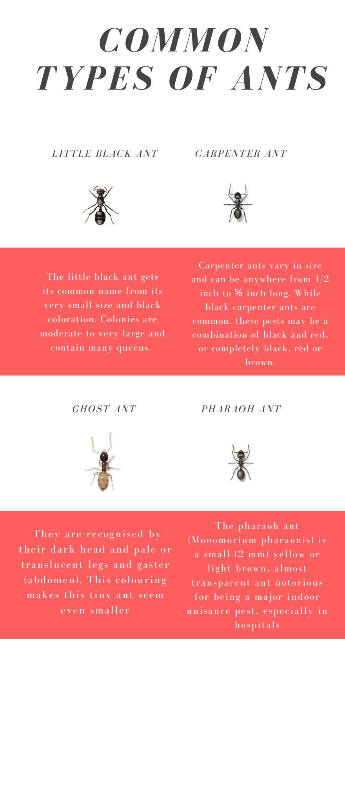
Image A:
The target users are for our app design are senior citizen scientists (65+ years old).
Our task is to create an app that will identify insects
We need to consider the context in which the software will function
In this image I considered the fact the fact the elderly will likely have vision problems so making the image clear and direct will be beneficial.
Link to my infographic: https://www.canva.com/design/DAEdj9DNdAI/fJ56ZapoOoMVqBIQuPiZ-A/view?utm_content=DAEdj9DNdAI&utm_campaign=designshare&utm_medium=link&utm_source=publishsharelink

Slide 5
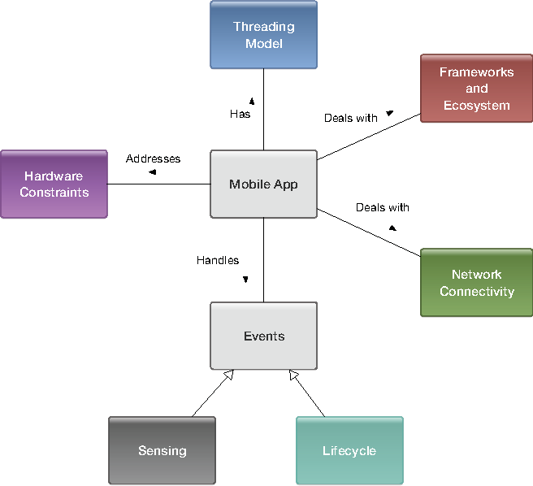
Johnson Principle 2: Consider function first, presentation later
Image B:
Develop a conceptual model
Focus on how the application is going to actually work and run before thinking about the design and presentation of it.
Picture (Figure 2) link: https://www.semanticscholar.org/paper/A-Conceptual-Model-for-Architecting-Mobile-Barnett-Vasa/be1fa101026e6ac3f8de8081b8308134da40b554

Slide 6
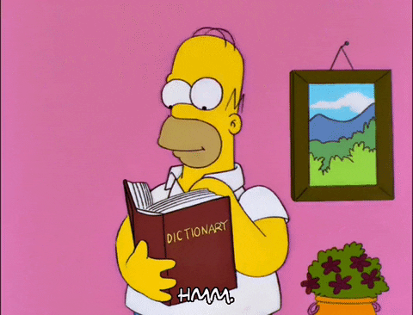
Johnson Principle 3: Confirm to user’s view of the task
Strive for naturalness
Use users’ vocabulary, not your own
Keep program internals inside the program
Find the correct point on the power/complexity trade off

Slide 7
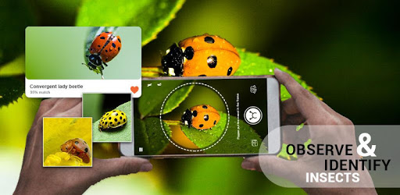
Image C:
The most natural way elderly scientists can find out about different insects is to simply take a picture of the ones they see
Our system will then match the picture to the most likely insect it looks like
Image link: https://play.google.com/store/apps/details?id=com.mm.insects.identification&hl=en

Slide 8
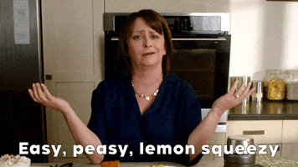
Johnson Principle 4: Design for the common case
Make common results easy to achieve
Two types of “common”: how many users versus how often/
Design for core cases; don’t sweat “edge” cases.
Essentially focus on common results without worrying to much about the outliers

Slide 9
Image D:
As mentioned earlier, our design will match the picture the user took to that of the pictures we have stored in our database.
There may be times when pictures are taken that don’t match any of the pictures we have in our database.
That is fine because we aren’t worried about the outliers for now.
We are seeking to improve our design and make it easily accessible to our target audience first.
Image link: https://play.google.com/store/apps/details?id=com.mm.insects.identification&hl=en

Slide 10

Johnson Principle 5: Don’t complicate the user’s task
Don’t give user extra problems
Don’t make users reason by elimination

Slide 11
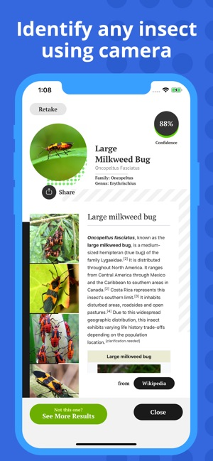
Image E:
We don’t want to confuse our users.
Our app will be simple and direct.
Simply open the app, take a pic of the insect, and view the description of the insect.
We will also add a library for users to look at all of the information and pictures of insects we have saved in our database.
Image link: https://apps.apple.com/us/app/insect-identification/id1380105102

Slide 12
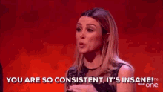
Johnson Principal 6: Facilitate learning
Think outside-in, not inside-out
Consistency is key
Provide a low risk environment

Slide 13
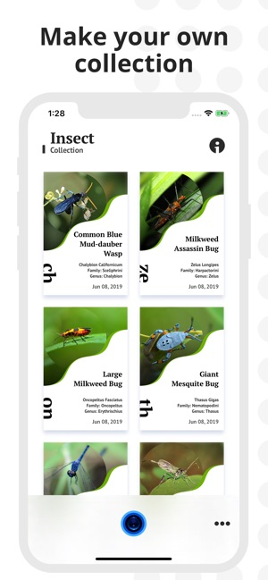
Image F:
Not only do we want users to be able to easily use our app, but we want them to consistently use it.
Being able to store all insects the users have found and automatically creating a collection will encourage users to not only seek out new insects but look back on the ones they seen so far!
Image link: https://apps.apple.com/us/app/insect-identification/id1380105102

Slide 14

Johnson Principle 7: Deliver information, not just data
Design displays carefully; get professional help.
The screen belongs to the user
Preserve display inertia.

Slide 15
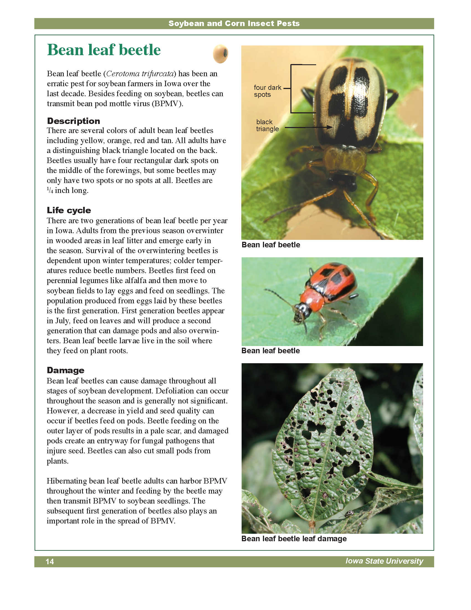
Image G:
One of the most important aspects of our app and design in general, is the ability to accurately portray information.
Once, the user finds the insect or searches the database for other insects, they will be shown a variety of accurate information on that insect.
Information such as description, life cycle, and the damage it can do.
Image link: https://www.ipm.iastate.edu/field-crop-insects

Slide 16
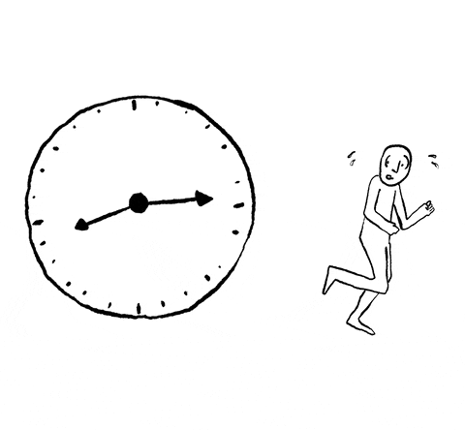
Johnson Principle 8: Design for responsiveness
• Acknowledge user actions instantly.
• Let users know when software is busy and when it isn’t.
• Free users to do other things while waiting.
• Animate movement smoothly and clearly.
• Allow users to abort lengthy operations they don’t want.
• Allow users to estimate how much time operations will take.
• Try to let users set their own work pace

Slide 17
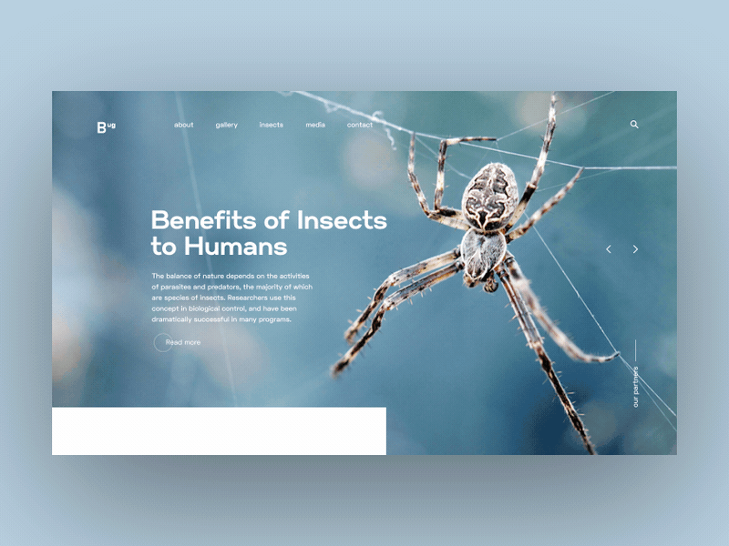
Image H:
It is important that users don’t feel like they are wasting their time while using our app.
Good design means that our app is responsive and quickly inputs the users action.
Our app will be very responsive and showcase movement as it is happening as shown in the image.
Image link: https://dribbble.com/shots/5813679-Insect-Daily-animated-UI

Slide 18
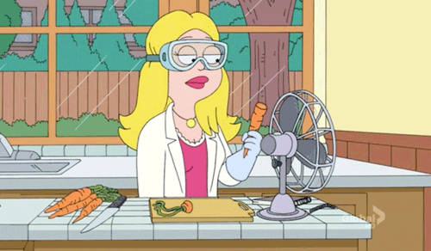
Johnson Principle 9: Try it on users; then fix it
• Test results can surprise even experienced designers.
• Schedule time to correct problems found by tests.
• Testing has two goals: informational and social.
• There are tests for every time and purpose.

Slide 19
Part B: Table of Gestalt’s Principle of Design
Information Visualization | Gestalt Principle Leveraged with description of the connection
Image A | Symmetry – I created an infographic that was even and had 4 pictures with four descriptions.
Image D | Similarity – This image showcases similarity because it matches the element of an insect with other potential insects that look similar to the picture of the insect taken.
Image H | Continuation – This image showcases continuation because the more the user moves the bottom part of the screen, more information will gradually start to appear.
Image G | Proximity- this image showcases proximity because it shows different variations of the same insect by placing two different pictures close together.
Image C | Figure-ground – This image showcases this gestalt principle because the more up close a user is able to take a picture of the insect, the more accurate the matching will be accurate. Also, image c showcases how the scale/size of the ladybug is relative to the background it is shown on (the leaf).

